Slide 1

DAYANANDA SAGAR COLLEGE OF ENGINEERING Department of Medical Electronics Engineering
“Mini project -3rd Semester”
"Progress Presentation”
USN | Name
1DS20MD025 | Nisarga V
1DS20MD029 | Prakruthi H U
1DS20MD018 | Laxmi
Under the guidance of
Prof. Murigendrayya M H
DEPARTMENT OF MEDICAL ELECTRONICS
DAYANANDA SAGAR COLLEGE OF ENGINEERING

Slide 2
“Covid-19 Social Distancing Reminder”

Slide 3
OBJECTIVES :
Development system that alert the people to maintain a 2-meter distance.
Implementing two functions that operating in two modes:
Mode 1: Alerting if someone comes close to the person
Mode 2: Measuring the temperature and the distance.
To formulate a system which works with the components available to produce the above desired results and evaluate it’s effectiveness.
Notes:
That is the purpose behind the project: to alert others to maintain a 2-meter distance from you.
It is a 2-in-1 as the thermistor is not only used to add accuracy to the distance measurement (the speed of sound changes depending on the temperature) but it also means that – by using a button or a touch sensor to switch between the modes – it can have two modes: alerting if someone comes close to you (Mode 1) and measuring the temperature and the distance (Mode 2). The measuring mode shows the temperature and the distance on the LCD.

Slide 4
LITERATURE SURVEY :
SN | Author | Title/ Year | Inference
1 | GAA Alvarez , MB Garcia. | “ Automated Social Distancing Gate with Non-Contact Body Temperature Monitoring using Arduino Uno “ 2020. | Social distancing is maintained inside the gate and the body temperature of each individual entering is monitored automatically.
2 | A Dubov , S Shoptawb – The American Journal of Bioethics. | “The value and ethics of using technology to contain the COVID-19 epidemic “ 2020-Taylor & Francis . | Digital contact tracing can accelerate identifying newly diagnosed patients, instantly informing past contact about their risk of infection, and supporting social distancing .
3 | M Ghai, R Gupta – International Journal of Sensor Networks . | “Ultrasonic Sensor Based Social Distancing Devices”2020 | It helps the person to remained of having social distancing. The hardware, run by the Arduino programmed software, is small and can be easily done.

Slide 5
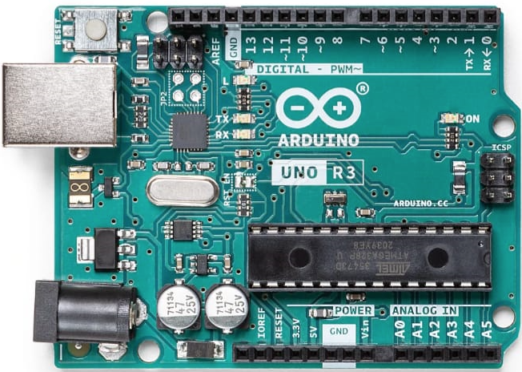
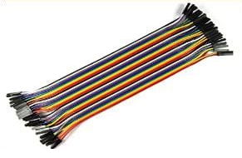
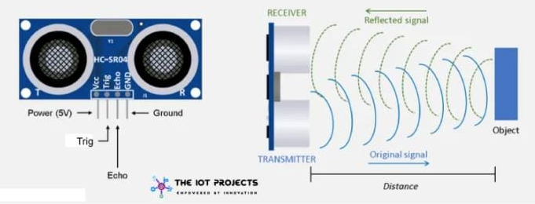

PROGRESS MODE:
COMPONENTS PURCHASED:
ARDUINO UNO → Rs. 400/-
ULTRASONIC SENSOR → Rs. 175/-
TOUCH SENSOR → Rs. 50/-
BUZZER → Rs. 50/-
JUMPING WIRES → Rs. 100/-
ROTARY POTENTIOMETER → Rs. 120/-
BREAD BOARD → Rs. 100/-
LCD DISPLAY → Rs. 100/-
OTHERS → Rs. 400/-
TOTAL COST → Rs. 1500/-
ARDUINO UNO
LCD DISPLAY
JUMPING WIRES
ULTRASONIC SENSOR

Slide 6
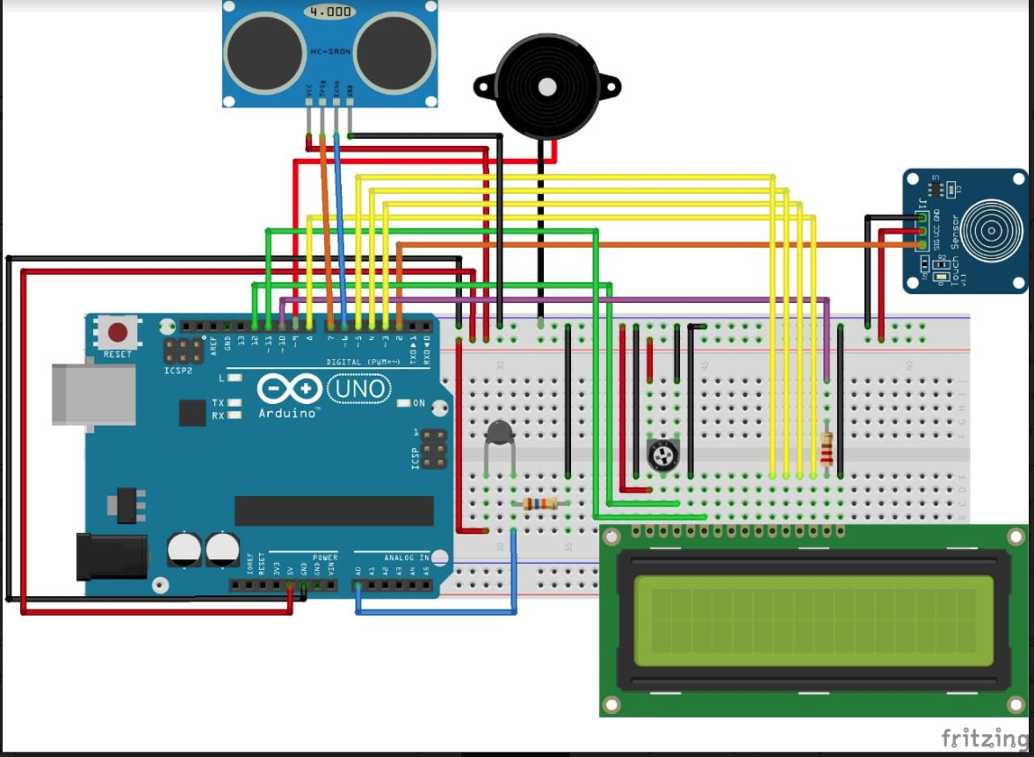
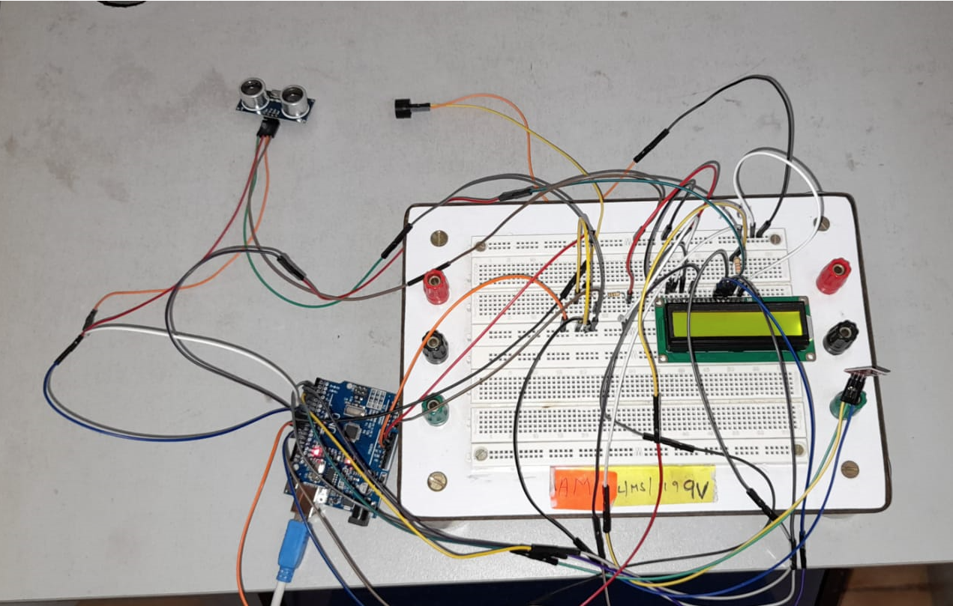
CIRCUIT DIAGRAM
Demo Video Link: https://drive.google.com/file/d/1Oy3rfprIrXpCjVEuk0h6kk0BuKyWpl6E/view?usp=sharing

Slide 7
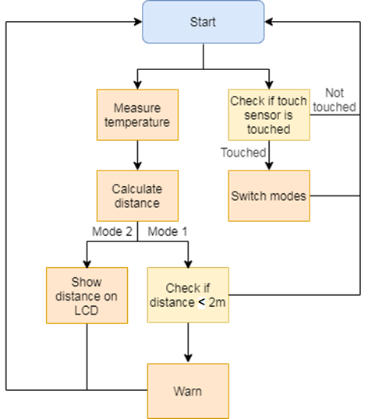
METHODOLOGY
Figure 1: System flow [1]
Notes:
How does it work?
The Arduino measures the temperature.
The temperature is used to calculate the distance with greater accuracy.
If the Arduino is on Mode 1:
If the distance is between 2m and 1m, the LCD backlight lights up and the LCD shows "Please keep away" and how far away the person is.
If the distance is 1m - 50cm the backlight of the LCD flashes and the LCD shows "Keep away"
If the distance is less than 50cm the backlight turns off and on twice a second and the LCD shows "STAY AWAY!"
If the Arduino is on Mode 2, the LCD shows the distance on the top and the temperature on the bottom of the screen.
To protect the components from the rain, I attached half a plastic bottle which can be pushed up when there is rain.
It can be attached to (using two pieces of string) and be easily removed from the bottom of a rucksack.

Slide 8
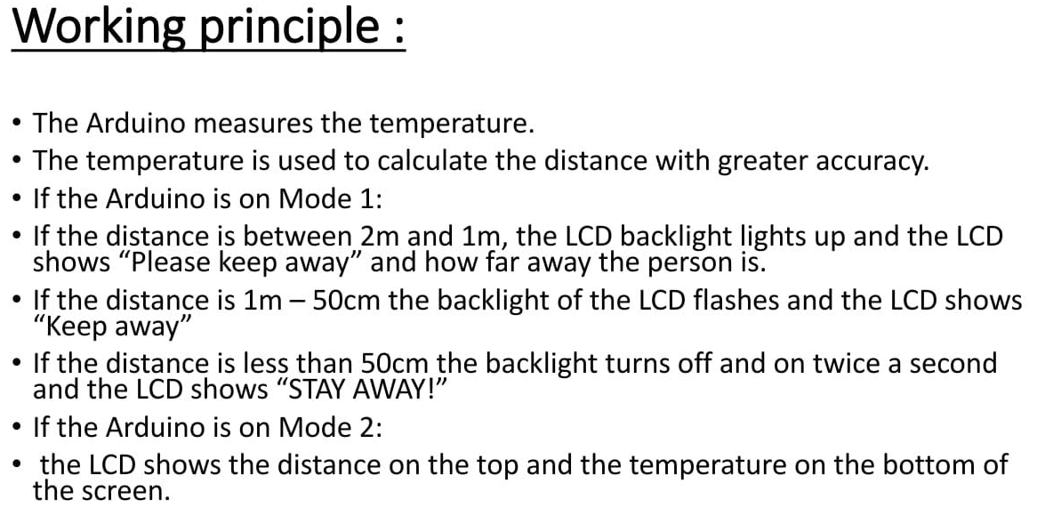

Slide 9
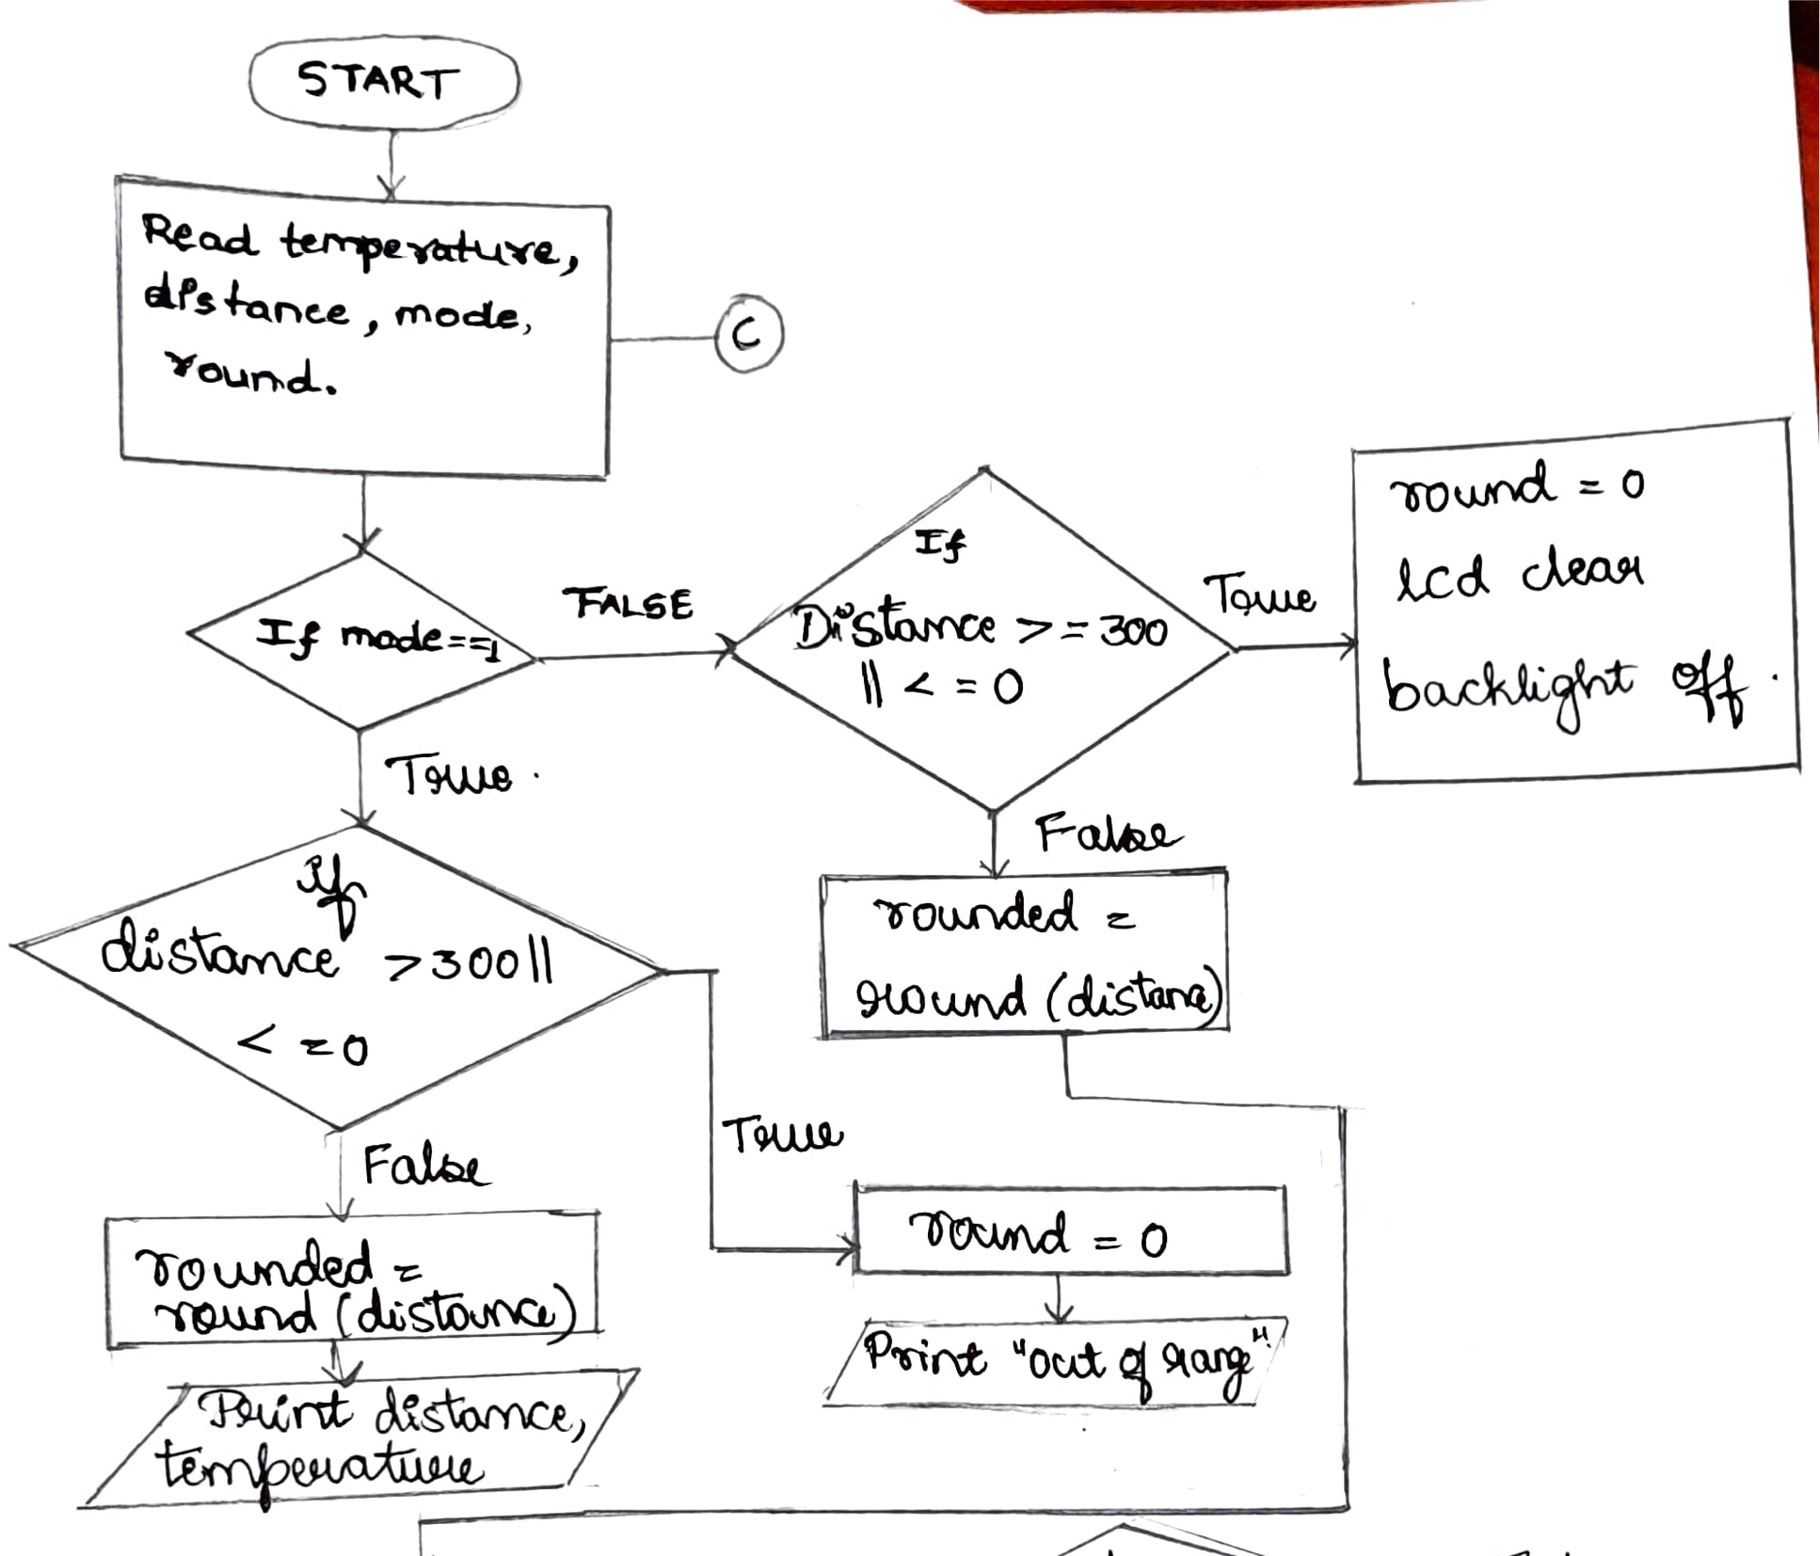
Software progress Flowchart

Slide 10
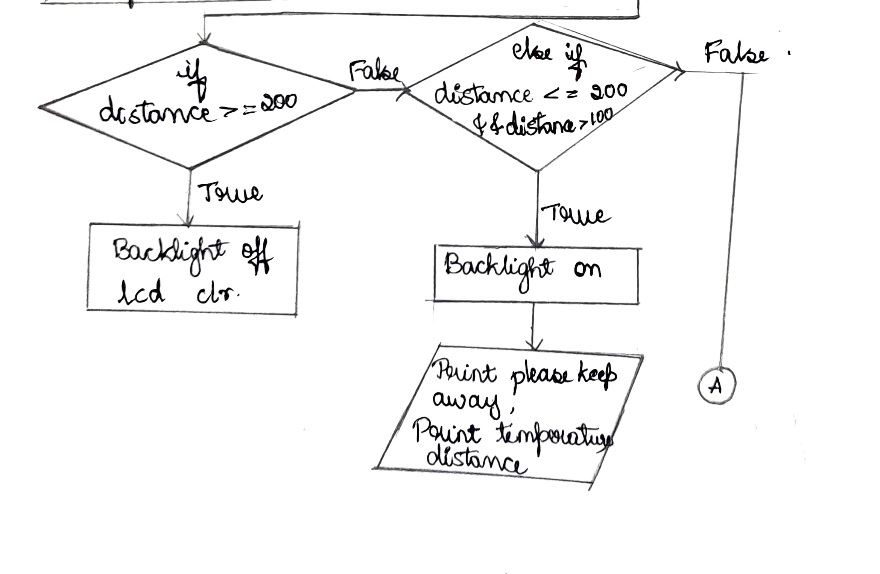

Slide 11
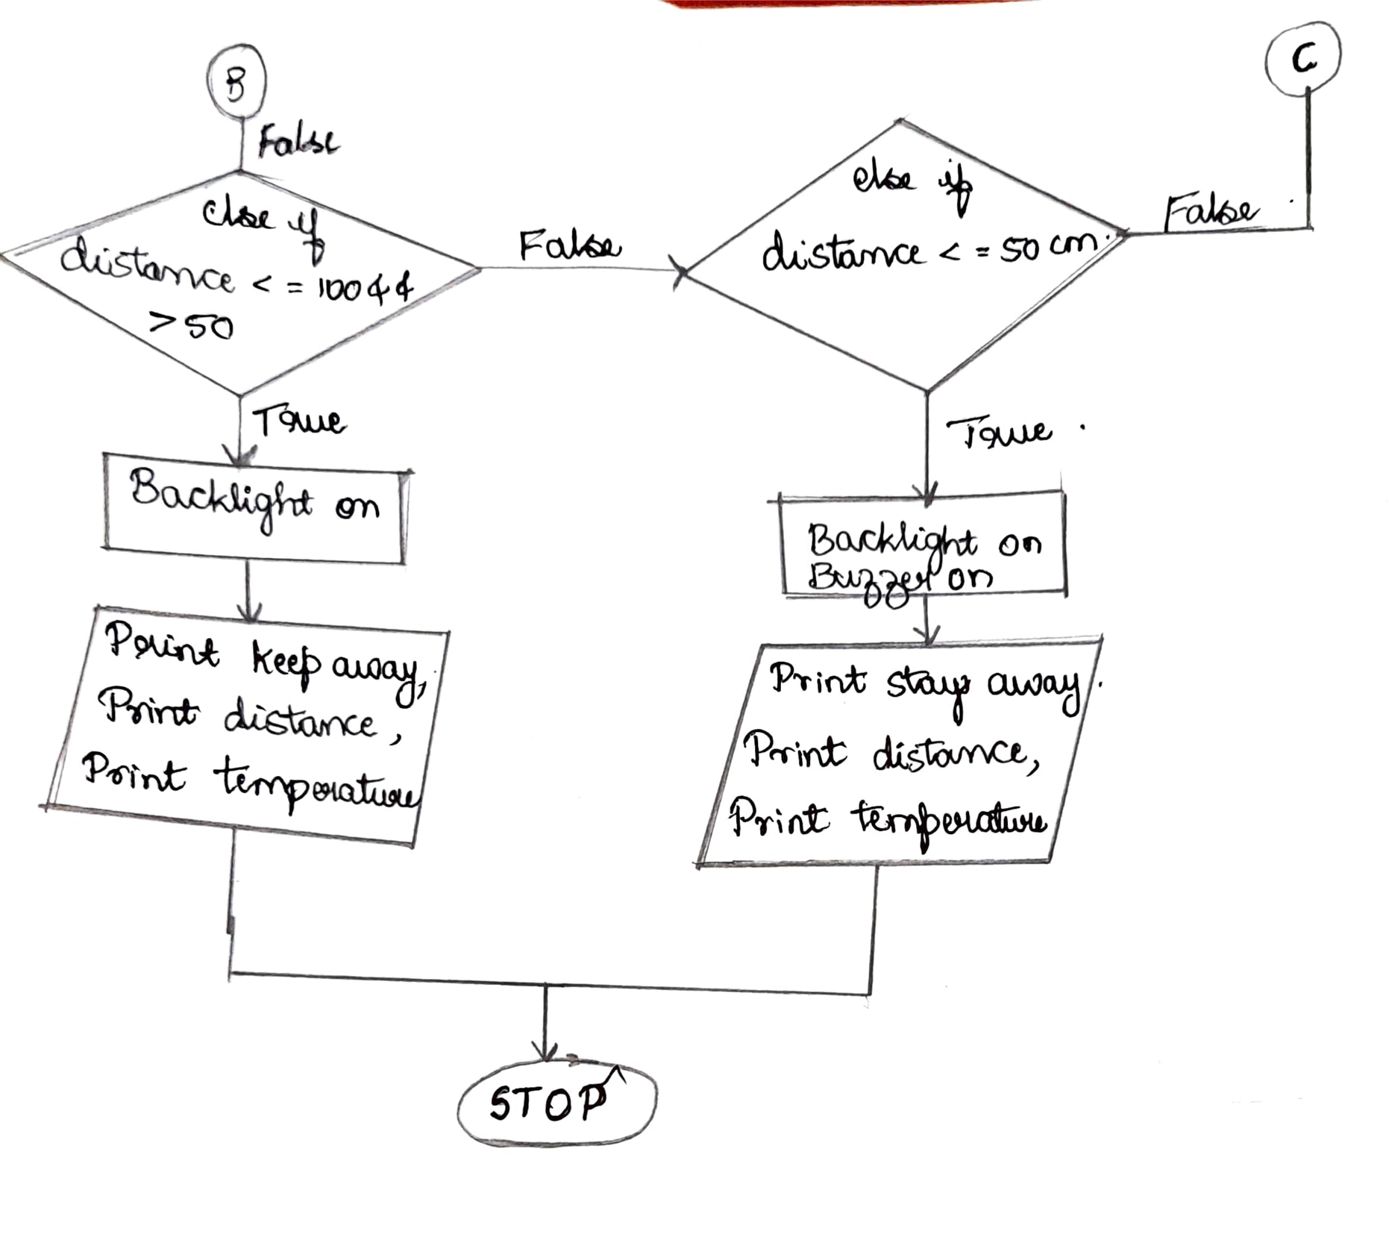

Slide 12
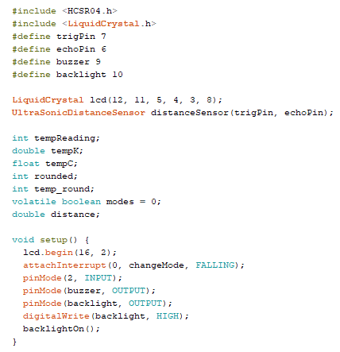
Code

Slide 13
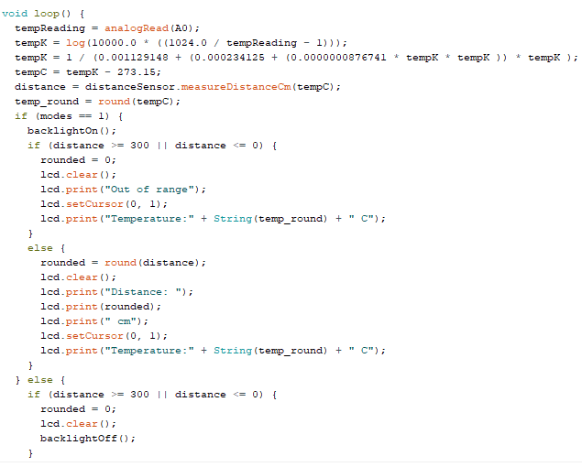
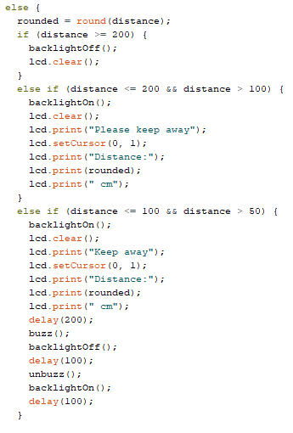
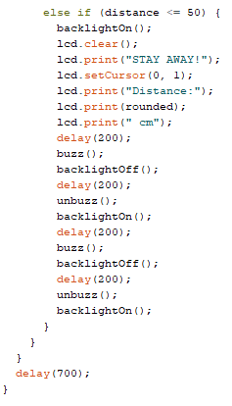
CODE Contd…

Slide 14

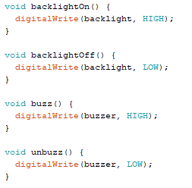
Code Contd…

Slide 15
OUTCOME OF PROJECT :
Arduino UNO platform with interfaces that
Alert the people to maintain a 2-meter distance .
Measure temperature and distance .
It prevents spreading of COVID .
Future scope of this work is :
Identify the person who is not following social distancing
Recognize the person who is having high temperature

Slide 16
09/11/21-18/11/21 : Working on Idea Presentation , Collecting the journal paper. 11/12/21-29/12/21 : Purchasing the components , working on code. 01/01/22-14/01/22 : Tweaking the device and finishing the report.
TIMELINE :

Slide 17
REFERENCES :
“COVID-19 tracker,” Republic of the Philippines, Department of Health, 23 July 2020, https://www.doh.gov.ph/covid19tracker.
Healthy Pilipinas, Philippine Department of Health, 24 July2020, https://covid19.healthypilipinas.ph/?lang=en.
“Coronavirus disease (COVID-19), Situation Report-185,” World Health Organization, 23 July 2020, https://www.who.int/docs/default source/coronaviruse/situation-reports/20200723-covid-19-sitrep-185.pdf?sfvrsn=9395b7bf_2.
T. Saminathan, A. Musipatla, P.M. Varma, P. S.Khan, P. and G.M. Kumar, “IoT Based Automated Waste Segregator for Efficient Recycling,” International Journal of Innovative Technology and Exploring Engineering, vol. 8, no. 6S, Apr. 2019, pp. 164-166.
S.M. Samreen, B. Gadgay, V. Pujari and B.Pallavi,“Automatic Metal, Glass and Plastic Waste Sorter,” International Journal for Research in Applied Science and Engineering Technology, vol.5, no. 6, Jun. 2017.

Slide 18
THANK YOU

